Slide 1
The Digital Abstraction

Slide 2
Index
Managing Complexity
Abstraction
Discipline
The Three -Y’s
Digitalization
Sampling
Quantization
Amount of information
Digital signal
Interaction with the Physical World
Boole Algebra

Slide 3
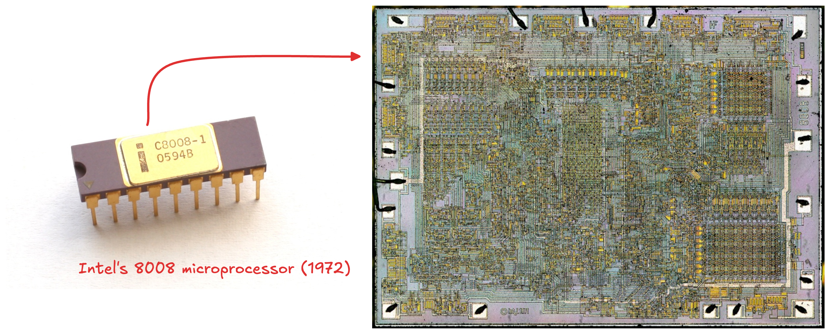
Complexity (1)

Slide 4
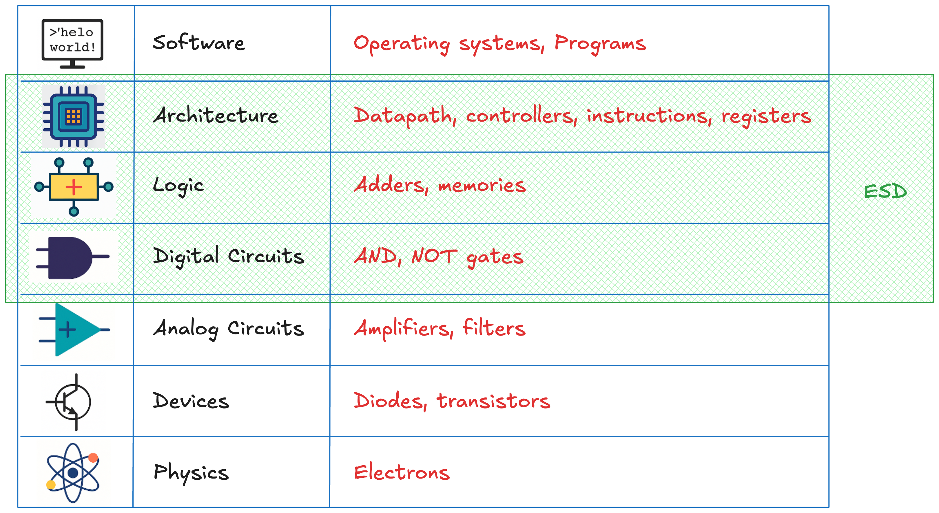
Abstraction

Slide 5
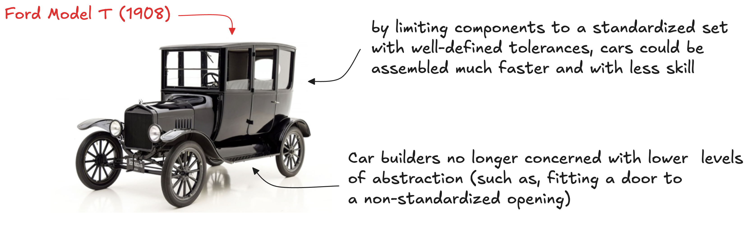
Discipline
Intentionally restricting the design choices
“Any customer can have a car painted any colour that he wants so long as it is black”

Slide 6
The three -y
Hierarchy: brake system into smaller, understandable modules
Modularity: modules have clear functions and interfaces
Regularity: reuse uniform modules to simplify design
Ford Model T example:
car - engine - carburettor - smaller interchangeable parts (hierarchy)
coupling nut holds the fuel feed line to the intake elbow and it have a standardized diameter and thread pitch, tightened to a standardized torque by a standardized wrench (modularity)
nut can be sourced from many suppliers if size is standard (regularity)

Slide 7
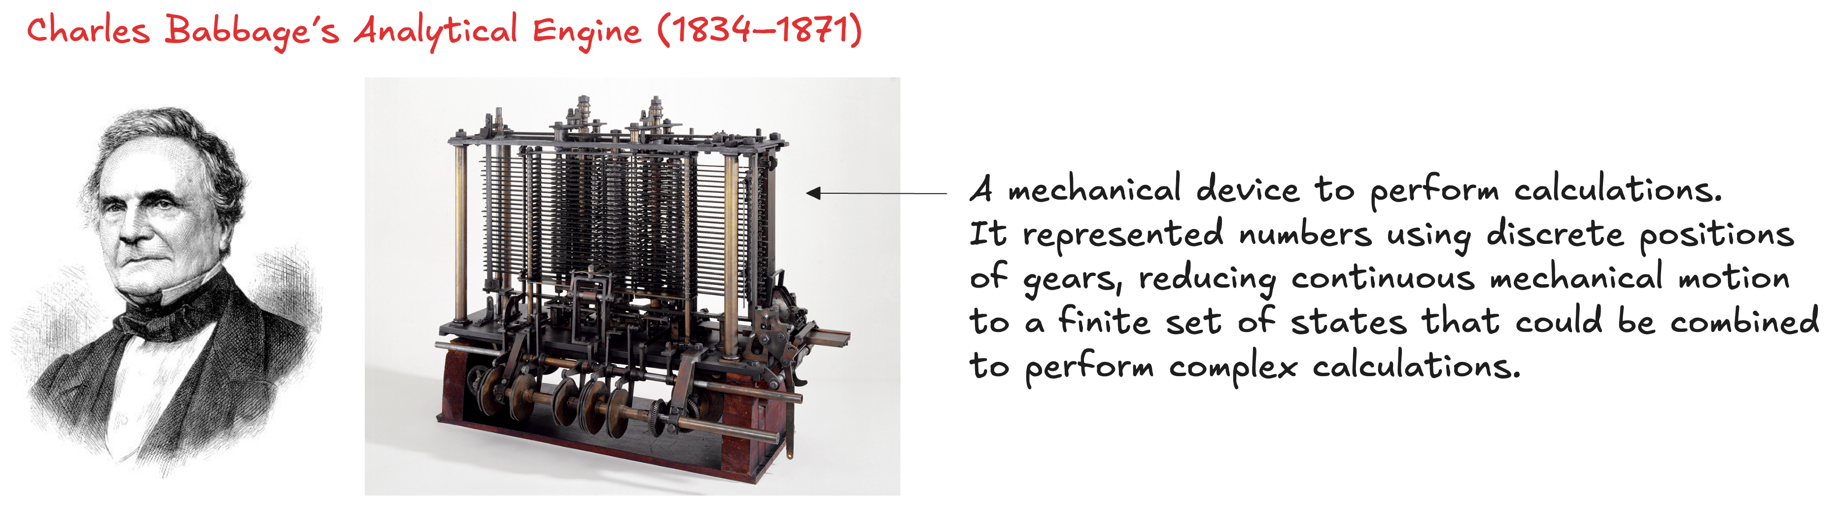
Digital Electronics
Analog: continuous voltages
Digital: discrete voltages (simpler design, scalable systems)
Digital devices (TVs, cameras, phones) replaced analog
Info as discrete variables
Early digital:
Modern digital:
binary (“0” = low V, “1” = high V): only two levels for reliability
why only two? It is easier to distinguish between two voltages than ten…

Slide 8
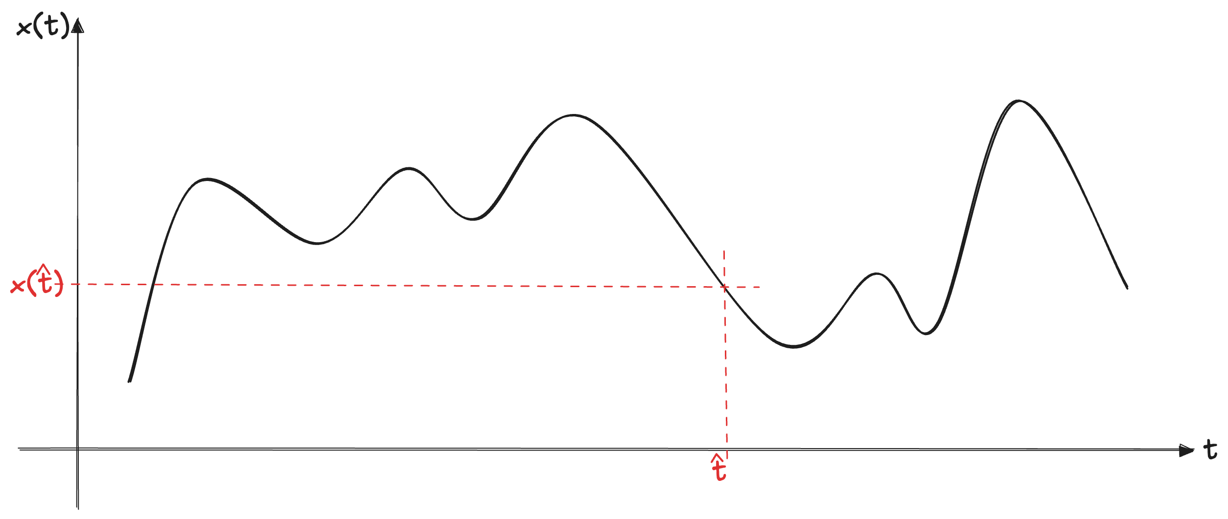
Digitalization
A physical phenomenon over time is continuous
e.g. temperature of a room, intensity of a light, force applied to an object, etc.
We need to digitize the signal both in time and in amplitude

Slide 9
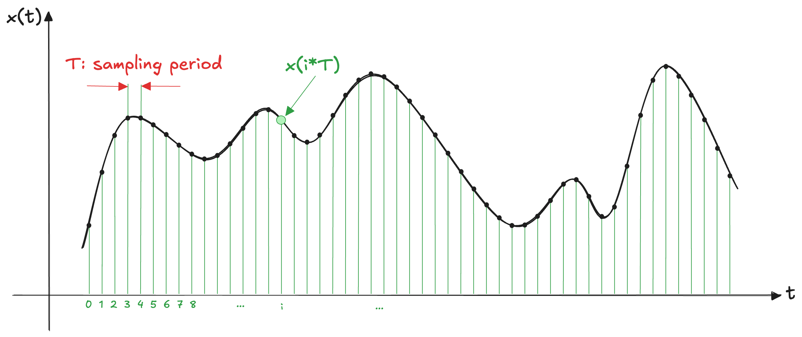
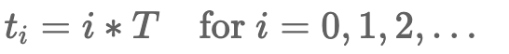
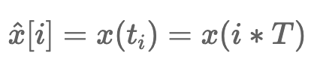
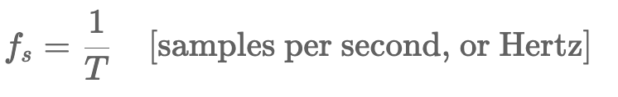
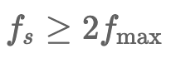
Sampling

Slide 10
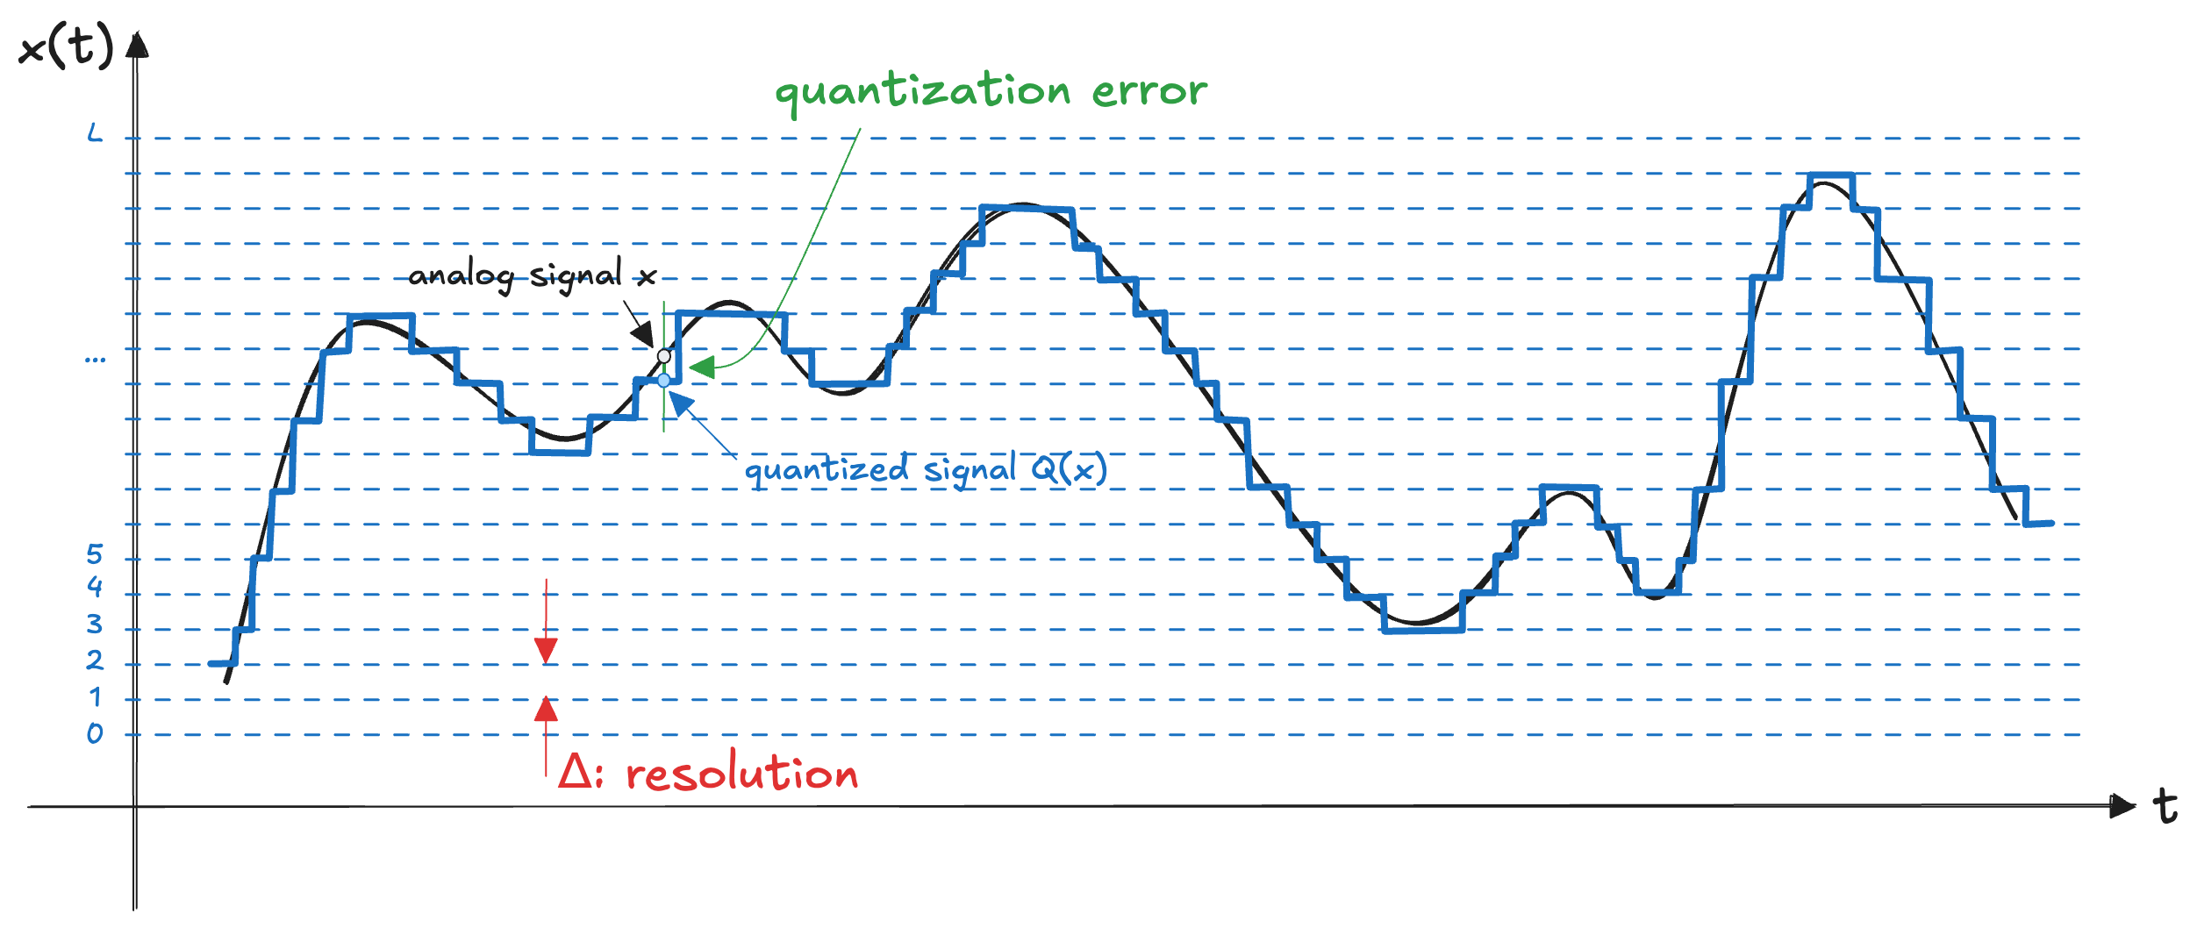
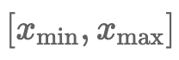
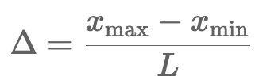
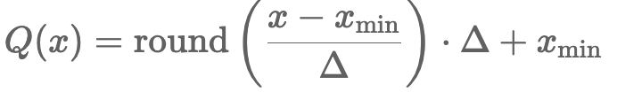
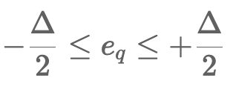
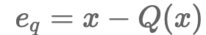
Quantization

Slide 11
The amount of information
A set of S symbols
A word of length D
We can obtain S^{D} distinct encodings
If we have a N objects to encode, then S^{D} >= N
In general, we know N and S and we need to find the minimum D >= log_{S} N
Binary variables S=2, D is measured in bits as:
D = log₂N [bits]
Examples:
A single binary variable has log₂2 = 1 bit of information
75 alphanumeric values (uppercase and lowercase characters, digits and special characters) needs 7 bit (ASCII)
A continuous signal contains an infinite amount of information
it can take on an infinite number of values
noise and measurement error limit the information to 10 to 16 bits

Slide 12
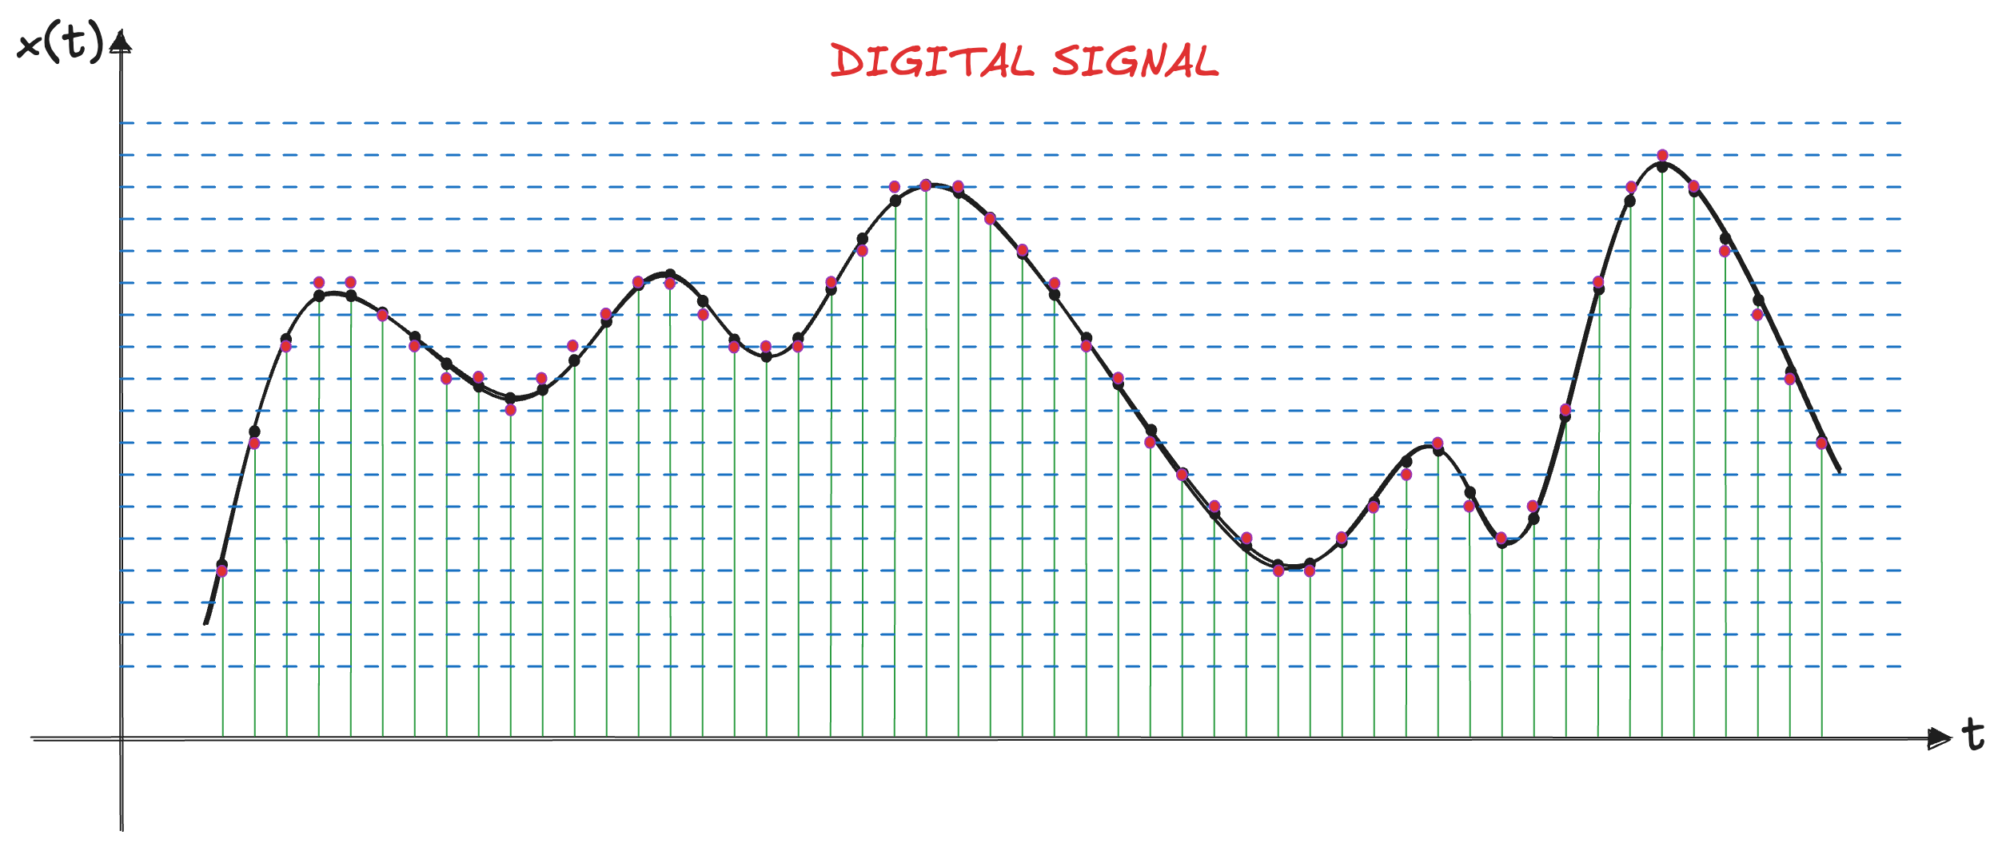
Digital signal
After the continuous signal is sampled in time and quantized in amplitude, the result is a sequence of discrete values that can be stored and processed by a digital system

Slide 13
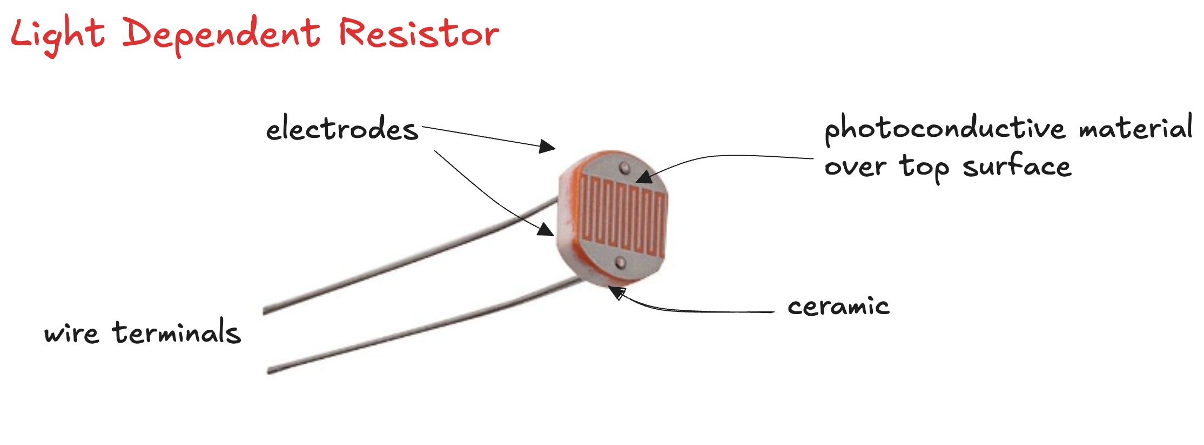
Interaction with the Physical World (1)
Sensors : devices that can sense physical phenomena and produce electrical signals that represent them

Slide 14
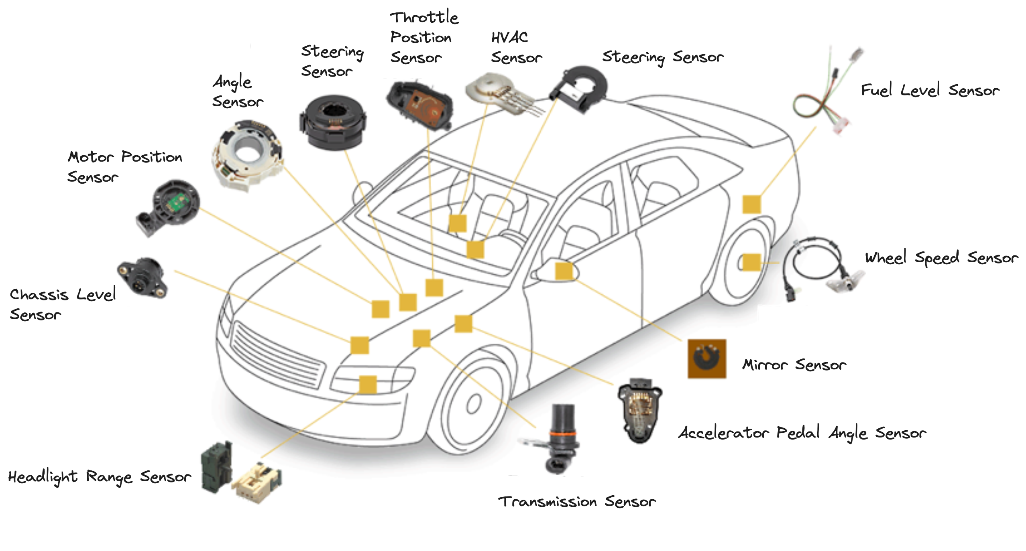
Interaction with the Physical World (2)

Slide 15
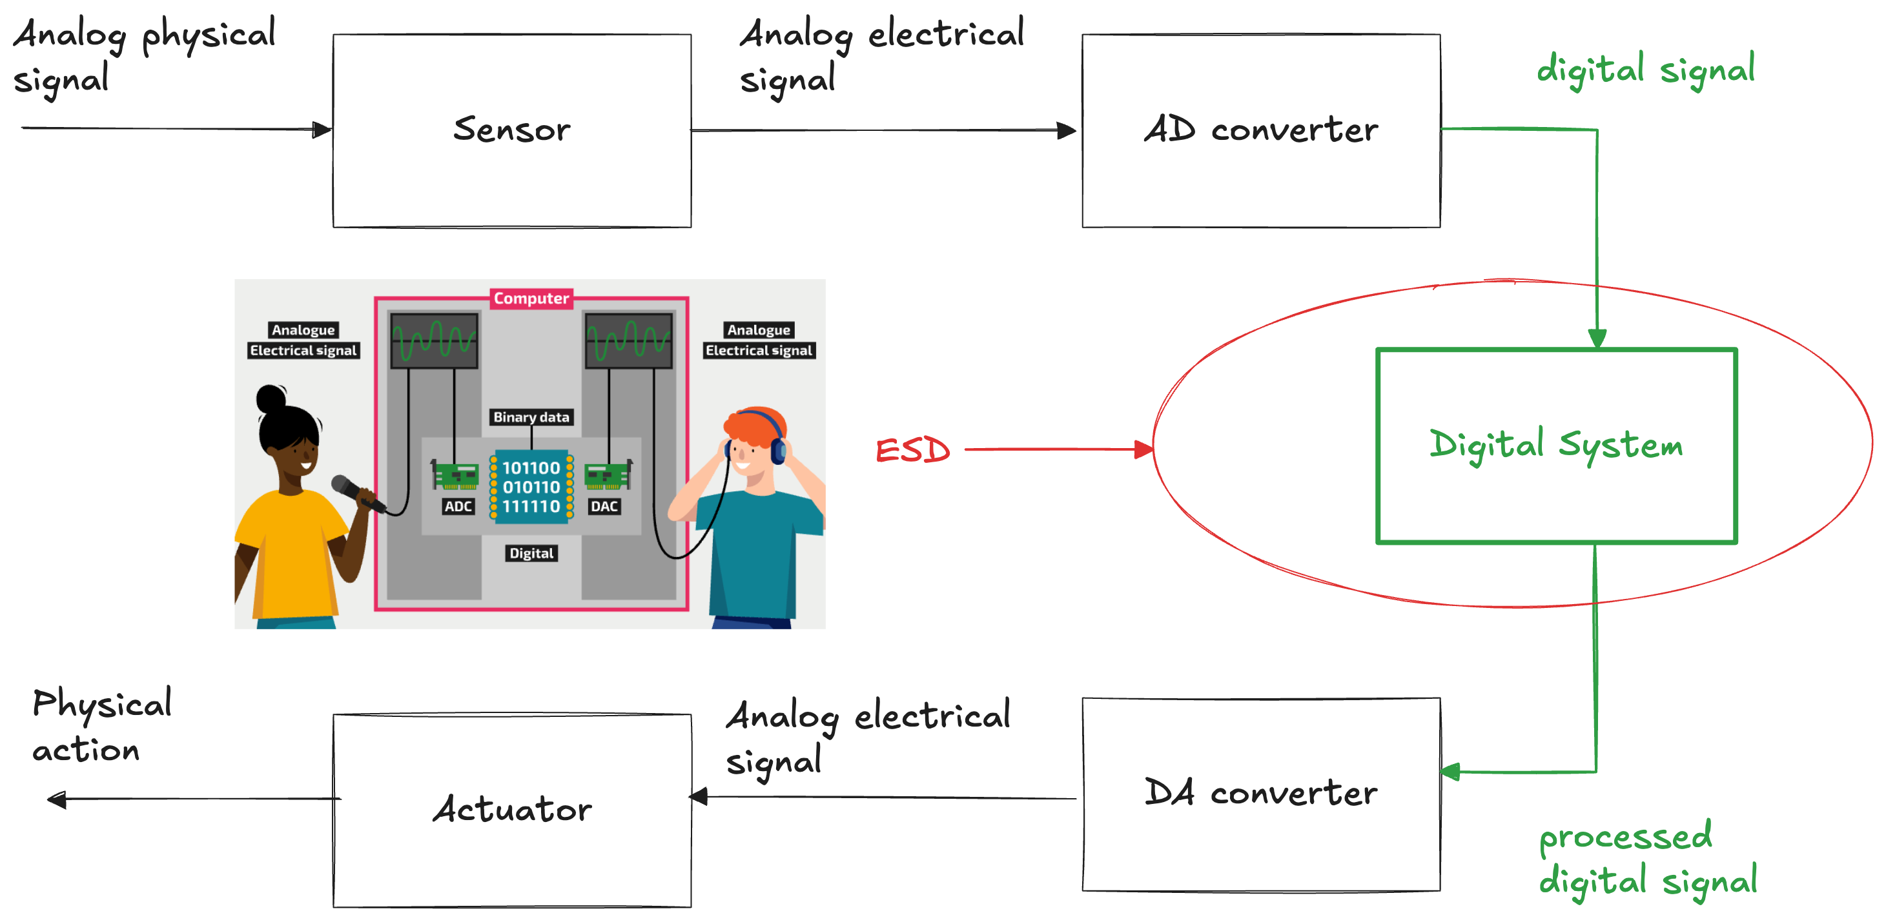
Interaction with the Physical World (3)

Slide 16
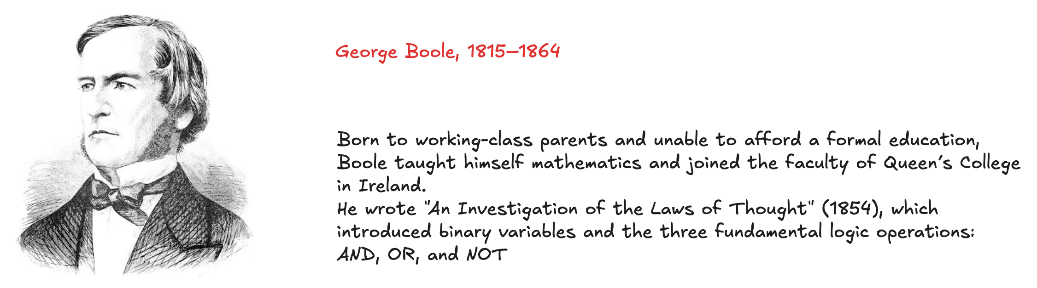
Boole Algebra
Digital signals may be treated with discrete math
The binary case: Boolean algebra
Digital abstraction: designers can focus on 1 and 0, ignoring whether the variables are physically represented with voltages, rotating gears, or even hydraulic fluid levels
Hardware designer can use Boolean algebra to model, analyse, and optimize circuits.

